Slide 1

Amazon Web Services
AWS, which stands for Amazon Web Services, is a comprehensive cloud computing platform offered by Amazon.com. It provides a wide range of cloud services, including computing power, storage, databases, networking, machine learning, analytics, security, and more. AWS allows individuals, businesses, and organizations to access and utilize these services on a pay-as-you-go basis, without the need to invest in and manage their own physical infrastructure.

Slide 2
Amazon EC2
Amazon EC2 (Elastic Compute Cloud) is a web service provided by Amazon Web Services (AWS) that allows users to rent virtual servers, known as instances, on which they can run applications and workloads. EC2 offers a scalable and flexible computing environment in the cloud. Users can choose from various instance types, each with different amounts of CPU, memory, storage, and networking capacity to meet specific application requirements.

Slide 3
AWS Load Balancers
An AWS Load Balancer is a service provided by Amazon Web Services (AWS) that distributes incoming network traffic across multiple targets to ensure high availability, fault tolerance, and optimal performance for applications and services hosted in the AWS cloud.
Load balancers act as intermediaries between clients (users, devices, or other services) and a group of backend instances (such as Amazon EC2 instances, IP addresses, containers, or Lambda functions), distributing traffic in a balanced and efficient manner.

Slide 4

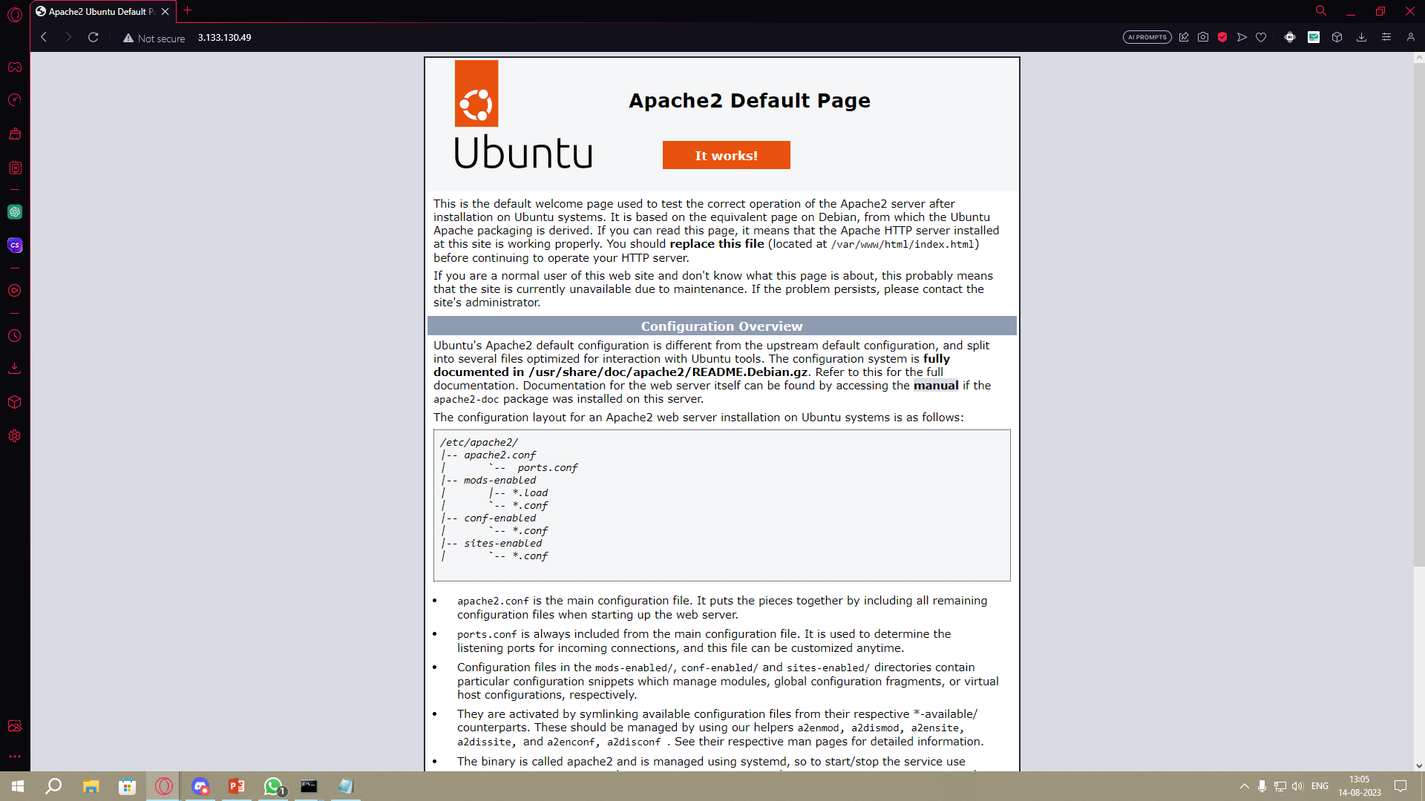
Instances Hand on
AWS
Ubuntu

Slide 5
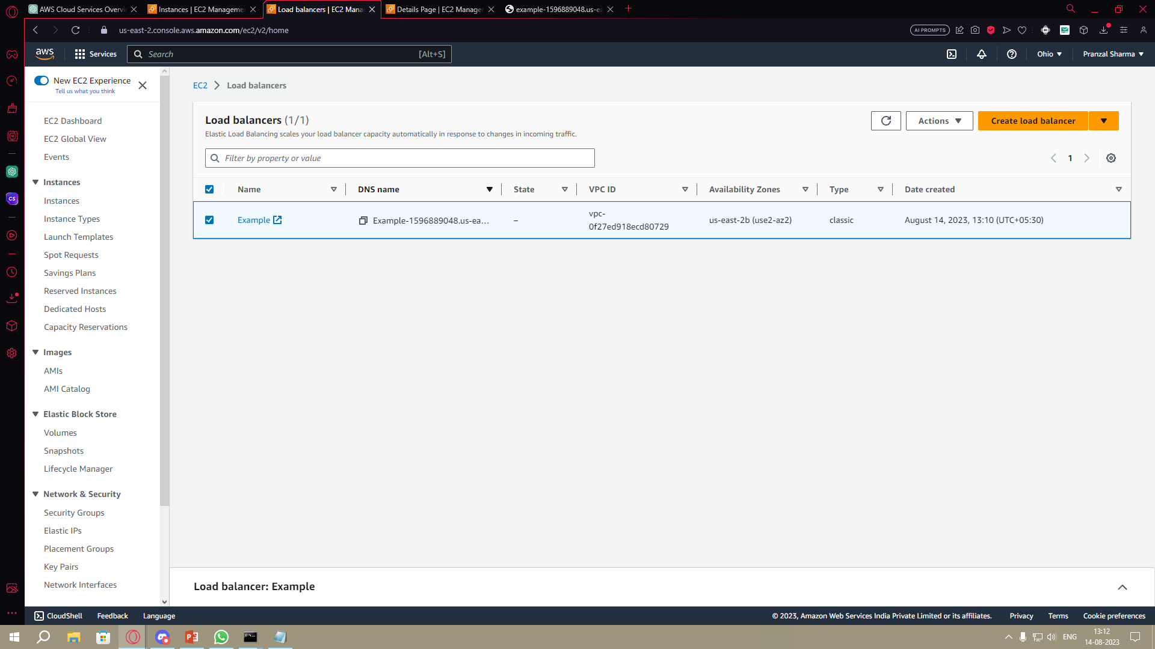
Load Balancer Hands on

Slide 6
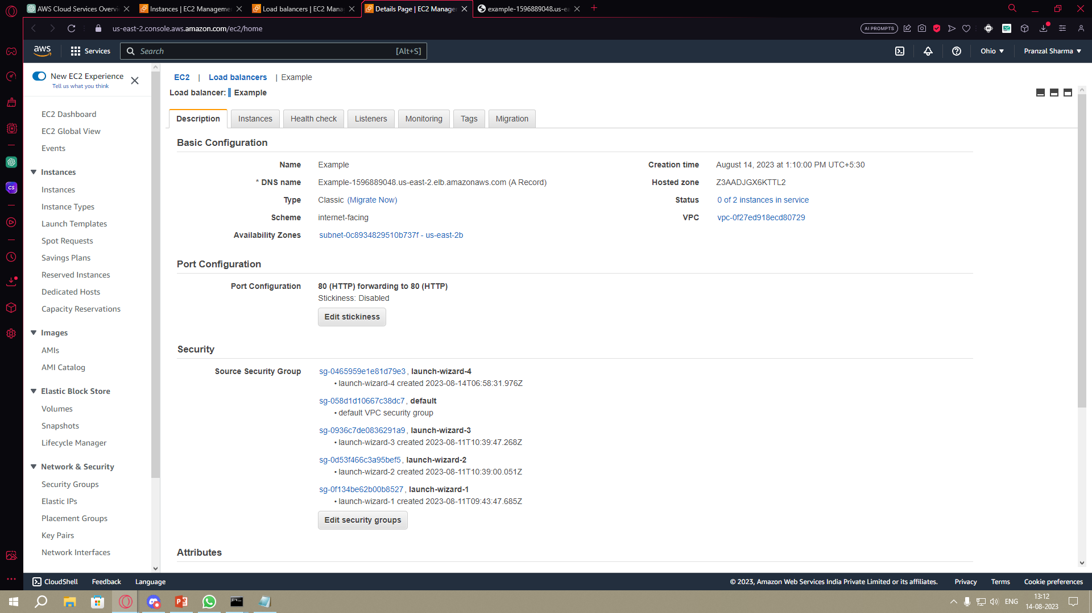

Slide 7
THANK YOU

